Slide 1


DONATION MANAGEMENT TRAINING FOR DC AGENCIES
Date: February 02, 2016
Location: Building 441 4th Street NW, Room 1107
10:00AM-11:30Am opgs.dc.gov/services Contact: 202 727 8900
Prepared by OPGS

Slide 2
Training Objectives
YOU WILL…
Understand How the Donation Process Works, its Benefits, and OPGS’ Assistance to Your Agency;
Become familiar with the District’s Rules of Conduct Governing Donations Made to the Government ;
Learn about Donation Ethical Requirements and its Non-Compliance Consequences.

Slide 3

Agenda
1- Overview OPGS
2- Background, Donation key definitions and Statistics
3- Donation Policies
4- Donation Process:
A- Online application-Quickbase
B- Legal Review process - MOLC
C- Donation Agreement
5- Financial & Foreign Donations
6- Non compliance consequences-BEGA
7- Summary & Next Steps

Slide 4

OPGS: CORE FUNCTIONS
Grant and Resource Development Support
Capacity Building
Collaboration and Partnership Building
Donations Solicitation Oversight and Management

Slide 5

DONATIONS BACKGROUND
The District of Columbia offers a unique state of the art donation’s process via QuickBase, which allows District Agencies and Schools, to solicit and accept donations from non District sources (Mayor’s Memorandum 2015-001)
Furthermore, the process ensures that these donations are accounted for and adhere to the ethics laws of the City.

Slide 6
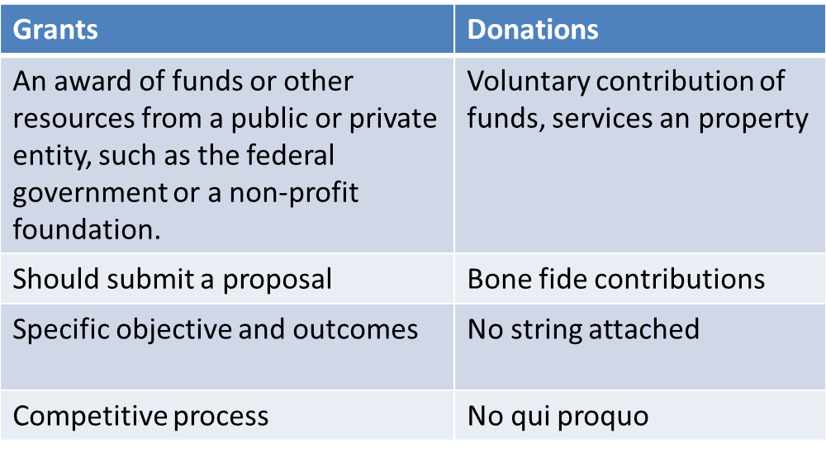
Definition:
DONATIONS VS. GRANTS
Donations and grants are NOT the same.
This training is exclusively about donations.

Slide 7

BENEFITS
It supports the Mayor’s Vision and Agenda
Protects you, your Agency, the Mayor and all DC Government staff from potential conflicts of interest
Augments Agency’s resources--both in-kind and financial to support programs and services
Encourages Donor support-provides more accountability and transparency for the donors

Slide 8
Donation statistics FY 2015

Slide 9
Type of donations FY 2015

Slide 10
Top Donation recipients FY 2015

Slide 11

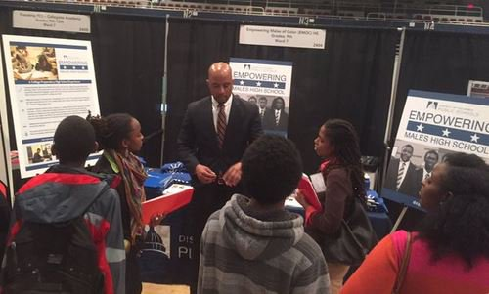
HIGHLIGHT DONATION FY 2015
Turnaround For Children donated $1.4 Millions for teacher practice and student support services to Hendley ES, Patterson ES, Wheatley EC, Orr ES and Walker-Jones EC to create a highly effective learning environment.
DC Public Education Fund donation of Programmatic Services and Curriculum Development Services valued at $5.2 Million to support program for males of color in the District.

Slide 12
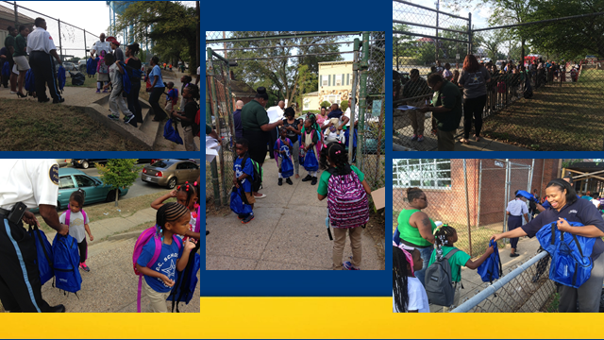
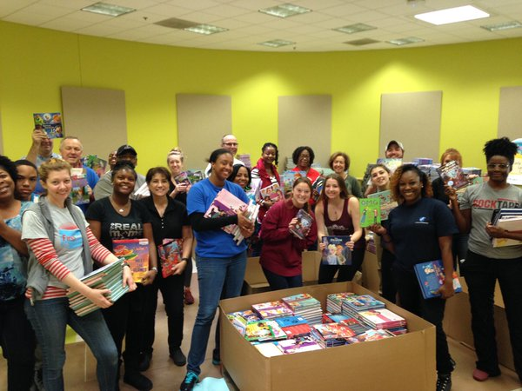
HIGHLIGHT DONATION FY 2015
Feed the Children donated $1.6 Million worth of books and school supplies to DCPS for its School and After School Programs.
.

Slide 13

DONATIONS POLICIES
Agencies may not solicit, accept, or use donated funds, services or property without prior approval by OPGS or OGC
Donations must be used for an authorized purpose of the Agency
Financial donations must be deposited in the Private Donation Funds 8450 (ACFO approves Budget Authority-Funds carry over)
No quid pro quo can exist
Donations = bona fide contributions
Donations of cash is prohibited
Link to the Mayor’s Memorandum 2015-001 (8/21/15) governing Donations in the District: http://opgs.dc.gov/node/243802.

Slide 14

DONATION APPROVAL PROCESS:
Only three steps:
Step 1: Online Application:
Agency prepares and submits an Application to Approve Donation (AAD) on Quickbase
Step 2: Legal Review
MOLC reviews your application for the legal sufficiency
Step 3: Donation Agreement
Agency fill out and sign the donation agreement form. Then have it signed by the donor and OPGS

Slide 15

DONATION APPROVAL PROCESS:
Step 1: Submit an application on Quickbase
Text in red = documents/tools to which you’ll need access in order to process donations; links are at end of the presentation.
 | Step |  | Action
 | Agency prepares and submits an Application to Approve Donation(AAD)
1 | Agency & donor | Agency has the donor read and approved the Mayor’s Memorandum
2 | Online application | Agency submits an application to approve donation via QuickBase Application. Go to octo.quickbase.com. Note-there is a separate 15 min training video on YouTube on how to submit an application on Quickbase- opgs.dc.gov/YouTube.

Slide 16
DONATION APPROVAL PROCESS:
Step 2: Legal review process
 | Step | Action
 | The Mayor’s Office of the Legal Counsel Performs the legal review
4 | OPGS and MOLC will receive your online application | OPGS and MOLC review your application and contact you if additional information is needed.
5 | Legal Review | MOLC will determine if your donation is legally sufficient. Common problems are: conflicts of interest and apparent advertising—quid pro quo—and endorsement concerns. MOLC will verify if the proposed donation is consistent with the agency’s authorized purpose or duty. At the end of the review, agency receives an email confirming that the application has been approved for the legal sufficiency or denied.

Slide 17
DONATION APPROVAL PROCESS
Step 3: Donation Agreement Form:
Agency fill out the Donation Agreement form and have it signed by the donor
Agency sends form and photocopy of the check to marcel.guy@dc.gov
Once the agreement is signed by OPGS, Agency can then accept and use the donation
The whole process takes up to 7 business days
Notes:
.

Slide 18

FINANCIAL DONATIONS
All financial donations must be deposited in the 8450 Private Donations Fund.
All checks must be made out to the DC Treasury,
Finance team (OFRM, OCFO) sets up attributes in GRAMS pointing to fund 8450.
Donation appears in SOAR (System of Accounting and Reporting).
Agency must provide the donation agreement with the check to the Fiscal officer using the newly created attributes to process the check in INOVA.

Slide 19

PROCESSING OF CHECKS
Send photocopy of check and Donation Agreement to Donations Manager at marcel.guy@dc.gov
Once the agreement is signed by OPGS, Your AFO can set up the attribute with OFRM and have them processed the check.

Slide 20

WIRE TRANSFERS
The recipient agency may accept a financial donation via a wire transfer between the donor and the D.C. Treasury
Bank Name: Wells Fargo
ABA Number: 054001220
Account Name: DC Government
Account Number: 2000043154623 – BANK ID 23W Reference: "Contribution for ----“

Slide 21

FOREIGN DONATIONS
Foreign donations are donations coming from a foreign source or donation covering the international travel expenses.
Agency must get the Mayor’s Chief of Staff approval before going through OPGS’ approval process.

Slide 22

NON-COMPLIANCE
CONSEQUENCES
Penalties for Non Compliance:
  BEGA may impose penalties
    Fines
    Public censure for elected officials and recommendations for removal
    Imprisonment.
- Your Agency may also impose penalties for non compliance.

Slide 23

Submit AAOPGS
Ag
Submit AAD Form to OPGS
OPGS Review
Legal Sufficiency Review from MOLC
OPGS and MOLC Complete Review
Donation Agreement with three required signatures
Accept and Use Donation
AAD: Application to approve donation
OPGS: Office of Partnerships and Grant Services
MOLC: Mayor Office of the Legal Counsel
OFT: Office of Finance and Treasury
Check Processed by OFT
OPGS Publishes Report

Slide 24
Next Steps
At the end of this training, OPGS will :
Give you access to Quickbase
Email you a Certificate of Completion
Provide additional donation resources as available

Slide 25


Questions & Scenarios

Slide 26


Key Contacts for the
Donations Process
Name Title Agency Phone Number
Betsy Cavendish Mayor’s General Counsel OGC 724-7681
Rob Hawkins Deputy General Counsel OGC 724-7681
Lafayette Barnes Director OPGS 727-8901
Marcel Guy Donations Manager OPGS 727-7977
Gregory Evans Associate Director MOLC 727-6960
Michael Bolden Division Director OFRM 727-6534
Najla Husseini Director, Schools Partnership DCPS 299-3334
Tanya Francis Supervisory Accountant DCPS 442-5244
Please visit OPGS’ website at www.opgs.dc.gov or email marcel.guy@dc.gov for more details.
To obtain a copy of the Donations Handbook, please go to eom.in.dc.gov

