Slide 1



CITYWIDE DONATIONS MANAGEMENT TRAINING
Prepared by OPGS
Responsive Government Promoting Partnerships for a Better DC

Slide 2
MEETING OBJECTIVES
YOU WILL…
Become familiar with the District’s Rules of Conduct Governing Donations Made to the Government;
Learn about Donation Ethical Requirements and its Non-Compliance Consequences;
Understand How the Donation Process Works, its Benefits, and OPGS’ Assistance to Your Agency.

Slide 3
OPGS’ MISSION
To enhance the capacity of District government agencies, community and faith-based organizations and nonprofits to identify, apply, and secure resources that advance the Mayor’s top public policy priorities.

Slide 4
CORE FUNCTIONS
Grant and Resource Development Support
Donations Solicitation Oversight and Management
Executive Leadership and Organizational Development
Collaboration and Partnership Building

Slide 5
DONATIONS BACKGROUND
The District of Columbia offers a unique and state of the art donations process, which allows District agencies, including DCPS, to solicit and accept donations from outside sources.
Furthermore, the process ensures that these donations are accounted for and adhere to the ethics laws of the City.

Slide 6
Legal Framework for the
District’s Donations Process
  Rules of Conduct Governing Donation Made to the Government (MM #)
  Key Definitions
  Non-Compliance Consequences
  Review of DC Ethics Rules by DC Board of Ethics and Government Accountability (BEGA)

Slide 7
KEY DEFINITIONS
A grant is an award of funds or other resources from a public or private entity that has specific objectives, outcomes, various terms and conditions in the award agreement.
The term donation is broadly defined to include the voluntary contribution of funds, services, and property.
Financial donations include all donation of funds (checks, money order, wire transfer). Donation of cash is prohibited.
In-kind Donations include items such as real property(land and improvement), personal property, services, and facilities.

Slide 8
DONATIONS POLICIES
AND PROCEDURES
Agencies may not solicit, accept, or use donated funds, services or property without prior approval by OPGS
Donations must be used for an authorized purpose of the agency
Financial donations must be deposited in the Private Donation Funds 8450 (ACFO approves Budget Authority-Funds carry over)
Donations ≠ contracts or grants
No quid pro quo can exist
Donations = bona fide contributions

Slide 9
ACCOUNTABILITY AND TRANSPARENCY
Donations will be individually reviewed by the OPGS’ Donations Manager and the Mayor’s Office of the Legal Counsel (MOLC).
Donations found not legally sufficient will not be approved.
OPGS will publish a quarterly report on its website of all the donations approved through the online donations platform (Quickbase).
In addition, at the end of each quarter OPGS will send donors thank you letters.

Slide 10

NON-COMPLIANCE
CONSEQUENCES
Penalties for non compliance:
  The Director of the Board of Ethics and Government Accountability may impose:
    Ministerial fines (appealable to the Board)
    Non-public informal admonition, period of probation (with possibility to expunge) (appealable to the Board).
  Board may impose:
    Fines of up to $5,000 per violation
    Fines of up to 3 times the amount of unlawful contribution, expenditure, gift, honorarium, or receipt of outside income for each violation
    Remedial action
    Public Censure
    Period of Probation (with possibility to expunge)
    Negotiated Disposition, offered by Director with approval by Board

Slide 11
NON-COMPLIANCE
CONSEQUENCES
  It is anticipated that for violations of the Code of Conduct that substantially threaten the public trust, the Board of Ethic and Governmental Accountability will be authorized to impose:
    A fine of up to $25,000, or imprisonment of up to one year (but not both)
    Public censure for elected officials and recommendations for removal
Penalties imposed by BEGA are separate and apart from any corrective or disciplinary action taken by the employing agency

Slide 12
DONATIONS POLICIES
AND PROCEDURES

Slide 13

DONATION APPROVAL
PROCESS
Submit Application to Approve Donations (AAD) octo.quickbase.com
  Brief Demo of Quickbase Online Application
Receive Legal Sufficiency from MOLC
Complete Donation Agreement
Accept Donation
*process can take up to 15 business days

Slide 14
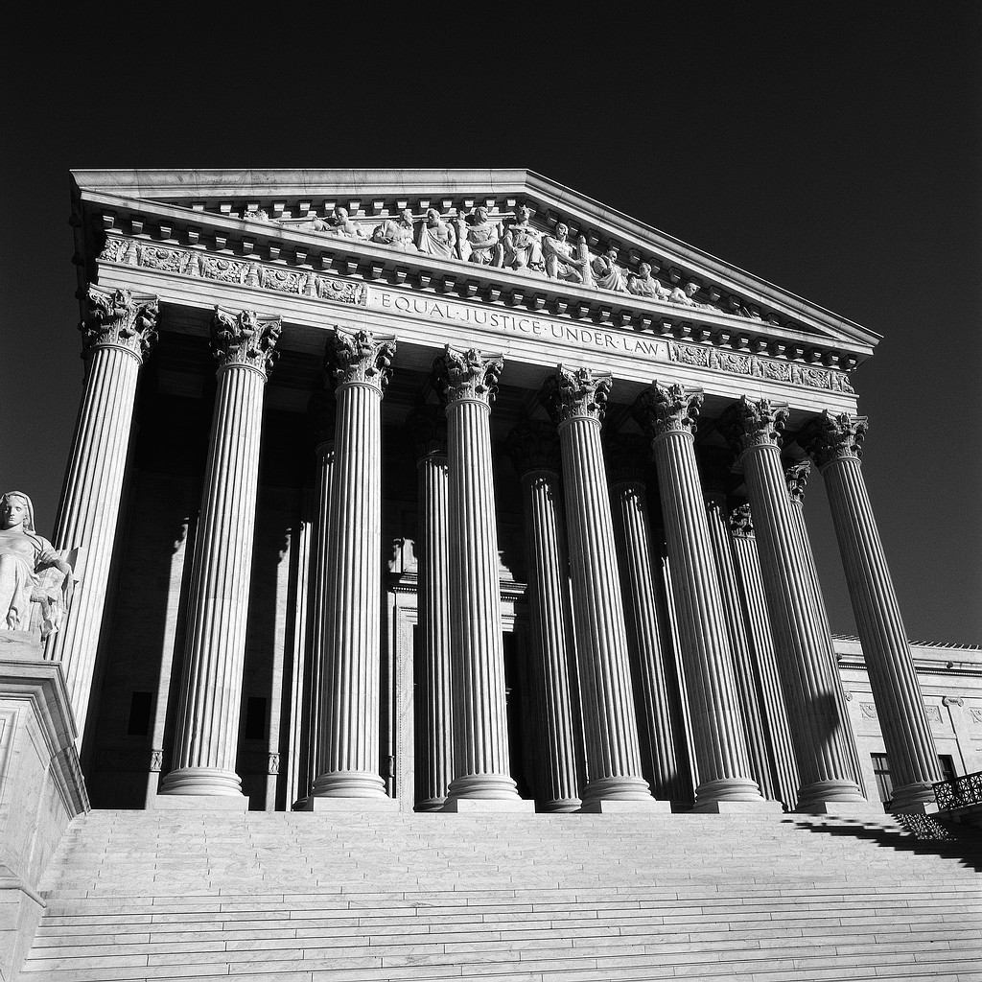
Legal Sufficiency
Performed by the Mayor’s Office of the Legal Counsel (MOLC)

Slide 15
LEGAL SUFFICIENCY
A review by the Mayor’s Office of the Legal Counsel (MOLC) to identify potential legal impediments , including violations of our government ethics rules, and to determine if the agency has legal authority to use the donation
Common problems involve possible conflicts of interest and apparent advertising—quid pro quo—and endorsement concerns
A review to determine if the proposed donation is consistent with the agency’s authorized purpose or duty
No authority from OPGS = No acceptance of donation

Slide 16
DONATION AGREEMENT
An agreement between donor and District government
Verifies that donation is bona fide and donated freely without expecting special treatment by the government
Confirms that all parties agree to the Rules of Conduct Governing Donations
Required to accept all authorized donations made to the District government

Slide 17
Sample Agreement

Slide 18

FINANCIAL DONATIONS
All checks must be made out to the DC Treasury.
Donation checks can either be sent to Treasury or processed through INOVA within the agency’s OCFO office.
Finance team sets up attributes in GRAMS pointing to fund 8450 (a grant/project number is created for each donation to help with tracking purposes).
After 24 hours of creating the attributes in GRAMS, the donation profile appears in SOAR.
The agency must provide the donation agreement together with the live check to the Fiscal officer using the newly created attributes to process the check in INOVA.

Slide 19

WIRE TRANSFERS
The recipient agency may accept a financial donation via a wire transfer between the donor and the D.C. Treasury
Bank Name: Wells Fargo
ABA Number: 054001220
Account Name: DC Government
Account Number: 2000043154623 – BANK ID 23W Reference: "Contribution for ----"

Slide 20

FOREIGN DONATIONS
All requests for donations made by, or solicited from, foreign governments, and (when known) by or from foreign private sources, must first be directed to the Mayor’s Chief of Staff for review and preapproval before going through OPGS’ approval process.

Slide 21
BENEFITS
Protects the Mayor, the Cabinet, and employees from potential conflicts of interest and supports the District’s ethics guidelines
Augments the Government’s in-kind and financial resources, which support our programs and services
Allows the District of Columbia Executive Branch to solicit, accept, and use donations from diverse donor sources

Slide 22
BENEFITS
Encourages more philanthropic community support for the Mayor’s top public policies
Promotes greater accountability and transparency in the District Government and compliance with the Anti-Deficiency Act
Ensures donors that their contributions are used for an authorized purpose of the requesting agency
Financial donations rollover from one Fiscal Year to another

Slide 23
Donation Statistics

Slide 24
Top Five Agencies Recipients Authorized by OPGS

Slide 25


DCPS After School Program for Children – Donated by Turnaround for Children ($2,000,000.00)
School leadership and management, teacher practice and student support services donated to Walker Jones ES and Orr ES to create a highly effective learning environment. Singer John Legend reads to DCPS students.

Slide 26
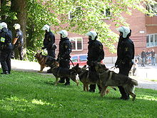
MPD’s donation of 6 canines donated by K2 Solutions Inc. ($45,720.00)
MPD received 6 canines to detect the scent trail explosives leave in the air, and proactively tract the scent back to its source.

Slide 27
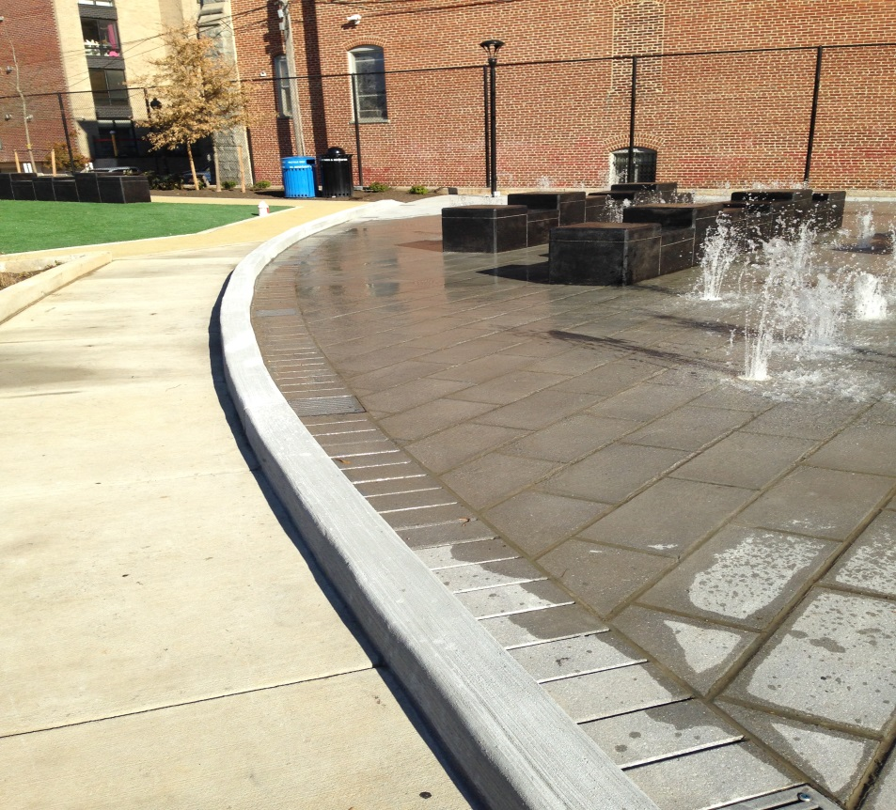
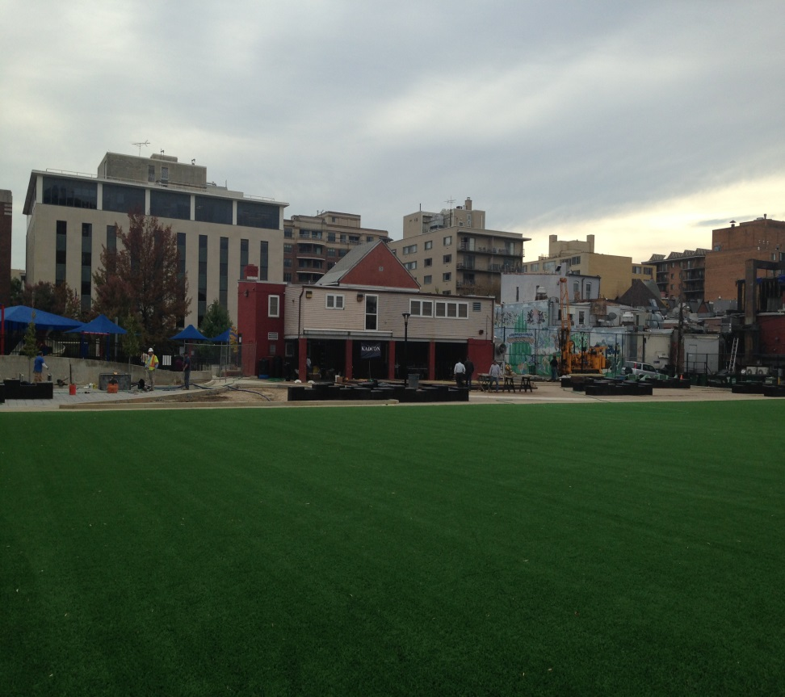
DPR/DGS renovation of the Stead Park donated by the Friends of Stead Park ($208,500.00)
Construction of a splash water park and outdoor stage at the Stead Park by the Friends of Stead Park.

Slide 28
REVIEW DONATION
PROCESS
Agency Inquiry
Submit AAD Form to OPGS
OPGS Review (up to 15 days)
Legal Sufficiency Review from MOLC (up to 15 days)
OPGS and MOLC Complete Review
Donation Agreement with three required signatures
Accept and Use Donation
AAD: Application to approve donation
OPGS: Office of Partnerships and Grant Services
MOLC: Mayor Office of the Legal Counsel
OFT: Office of Finance and Treasury
Check Processed by OFT
OPGS Publishes Report

Slide 29
Scenario 1:
1- Solicitation of retails store and recognition of donor logo on the website:
A District agency would like authority to solicit donations for its Back-to-School Campaign for local disadvantaged youth. The agency director plans to solicit several national retail stores – e.g. Ross, Banana Republic, Foot Locker, and Hecht’s – for back packs, school supplies, and clothing to support this campaign. In addition, the agency’s director would like to host a dinner reception for the students to give them the items and also recognize the donors for their support. Each donor’s logo would also be listed on the District’s website in recognition for their support.
  Question: Does this Agency request comply with the Rules of Conduct Governing Donations Made to the District and may the donor’s logos be listed on the District website?

Slide 30
Scenario 2:
Solicitation of vendors:
A District agency has submitted a request to OPGS to accept a donation from a publisher that would like to produce and sell a book on the history of the agency. The publisher would like to donate a percentage of the profits to the agency that would be used to support one of its core programs.
Question: Does the publisher’s offer comply with the Rules of Conduct Governing Donations made to the District?

Slide 31
Scenario 3
3- Solicitation of donation to support a nonprofit:
The executive director of the nonprofit has approached the agency director to assist its efforts to raise funds for the organization. The Agency director is requesting authority to solicit donations to support the nonprofit so it can continue to provide services to District senior citizens.
Question: Can the director solicit donations to support this important cause?

Slide 32
Scenario 4
4- Donation from vendors :
The director of an Agency plans to ask some of its vendors and their business competitors to donate up to $1000 each to offer incentive awards to its star employees. In return, the director would like to arrange private meetings with the Mayor and the donors as well as offer them special recognition – e.g. Gold and Silver awards – depending upon the amount they donate to the employee appreciation event.
Question: Can the director solicit financial contributions from its contractors and offer them different levels of recognition for their donations? Does the director’s plan to arrange private meeting with the Mayor create any conflicts with the Rules Governing Donations Made to the District?

Slide 33
Summary
Submit Application to Approve Donations (AAD) octo.quickbase.com
Receive Legal Sufficiency
Complete Donation Agreement
Accept and use the Donation
Enjoy Benefits

Slide 34
Key Contacts for the
Donations Process
Name Title Agency Phone Number
Betsy Cavendish Mayor’s General Counsel OGC 724-7681
Lafayette Barnes Director OPGS 727-8901
Marcel Guy Donations Manager OPGS 727-7977
Ronald Ross Deputy Director MOLC 727-6969
Michael Bolden Division Director OFRM 727-6534
Donna McKenzie Revenue Collections Manager OFT 727-0805
Tanya Francis Supervisory Accountant DCPS 442-5244
Please visit OPGS’ website at www.opgs.dc.gov or email marcel.guy@dc.gov for more details.
To obtain a copy of the Donations Handbook, please go to eom.in.dc.gov

